Slide 1
Machine Learning Unleashing the Power of AI

Slide 2


Introduction
Machine Learning (ML) is a branch of artificial intelligence (AI) .
which enables the machine to automatically learn from data.
improve performance from past experiences, and make predictions.
Machine learning contains a set of algorithms that work on a big amount of data.

Slide 3
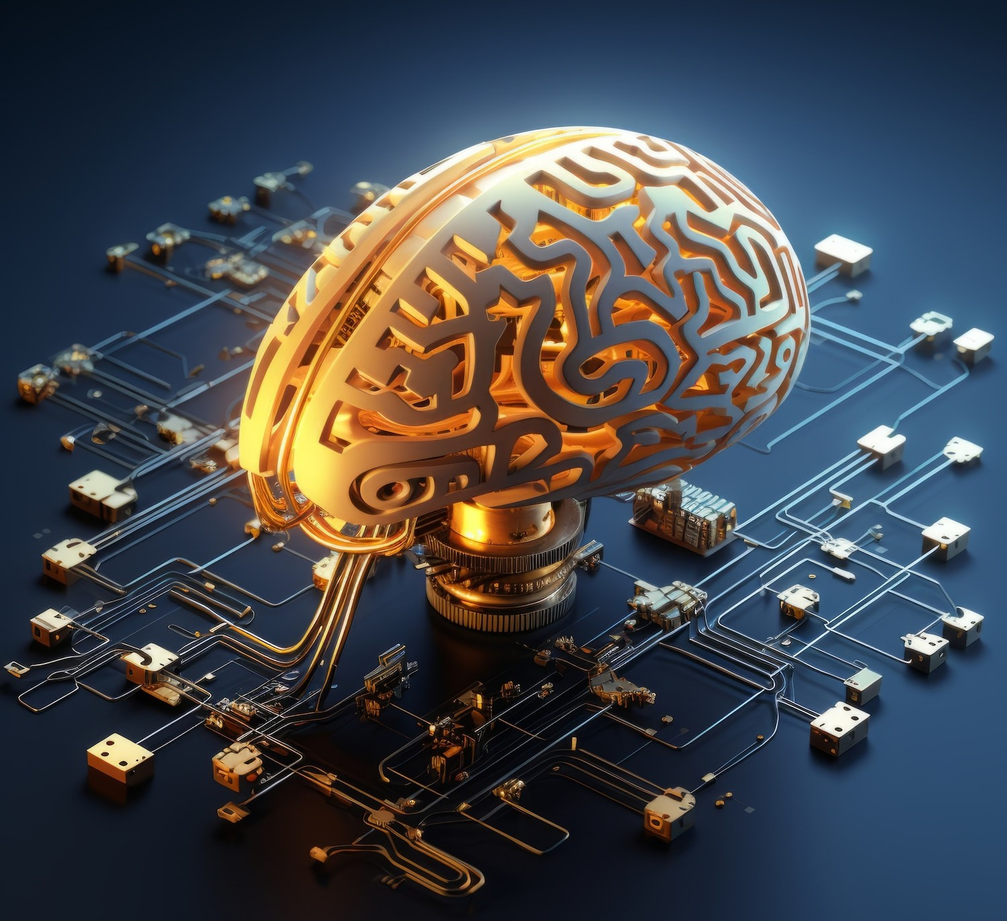
Types of Machine Learning
Supervised Machine Learning
Unsupervised Machine Learning
Semi-Supervised Machine Learning

Slide 4

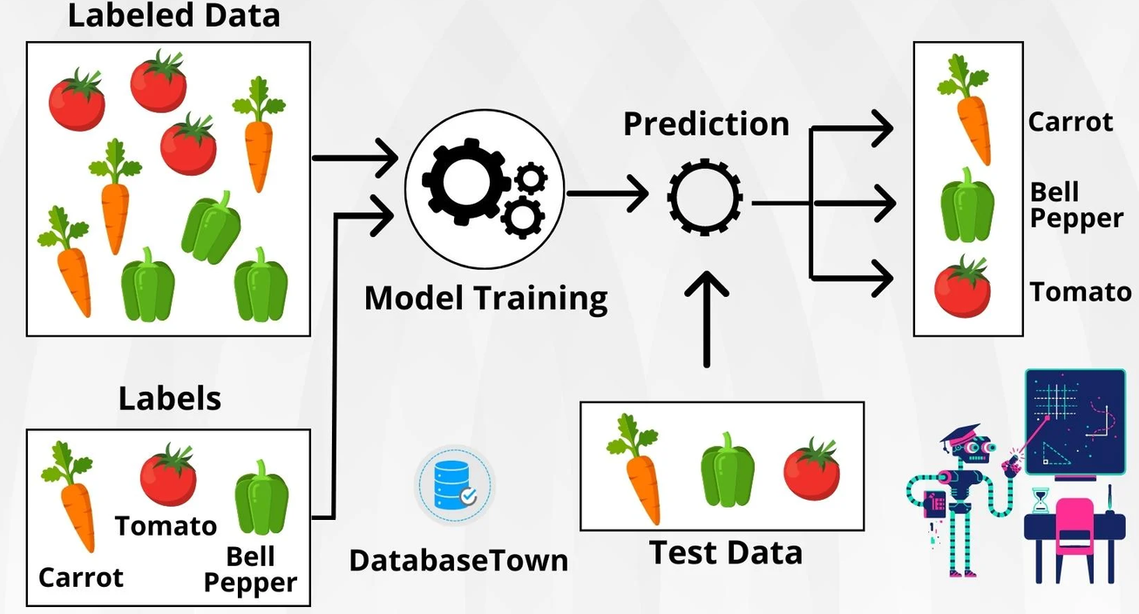
Supervised Machine Learning
As its name suggests, Supervised machine learning is based on supervision.
It means in the supervised learning technique, we train the machines using the "labelled" dataset, and based on the training, the machine predicts the output.

Slide 5
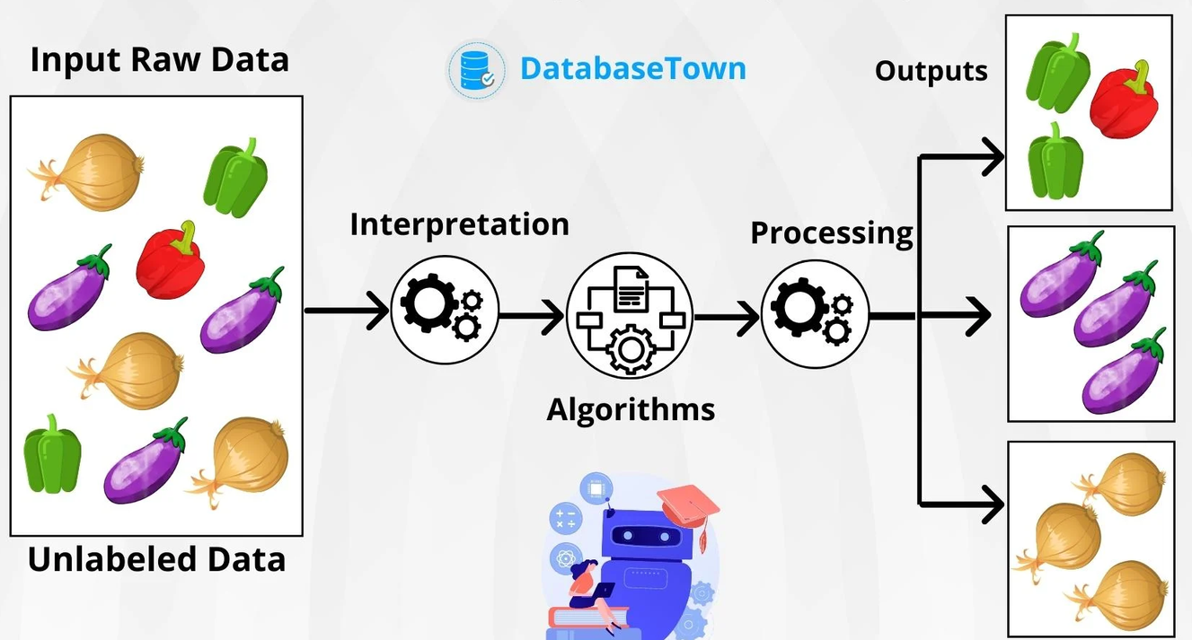
Unsupervised Machine Learning
Unsupervised learning is different from the Supervised learning technique; as its name suggests, there is no need for supervision.
It means, in unsupervised machine learning, the machine is trained using the unlabeled dataset, and the machine predicts the output without any supervision.

Slide 6


Key Components of Machine Learning
Labels:
Labels are the individual variables or attributes in the dataset that help the model make predictions.
Model:
The model is the core of machine learning. It's a mathematical representation or algorithm that maps input data to predictions the output or make Decision.
Algorithm:
An algorithm is a set of rules and statistical techniques that the model uses to understand patterns in the data.

Slide 7

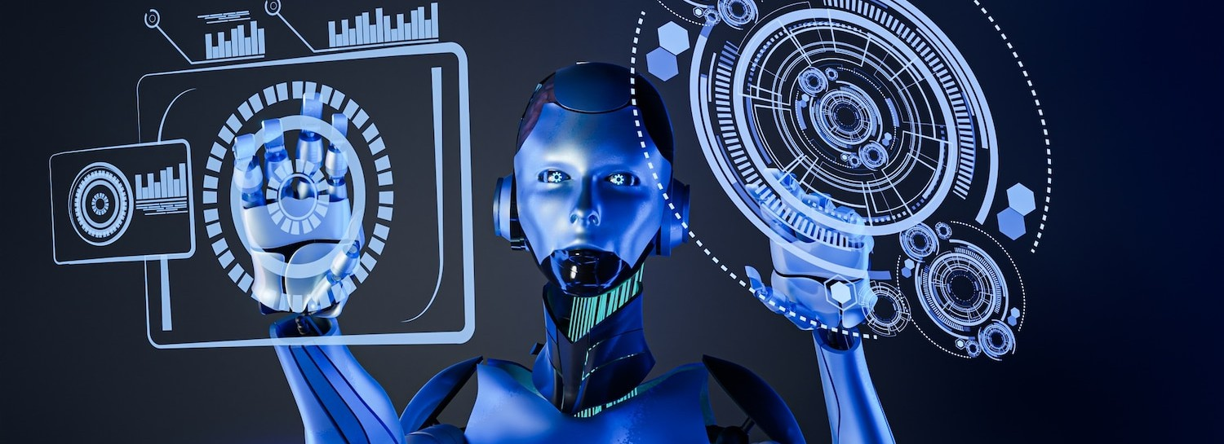
Advantages of Machine Learning
Automation: Automates repetitive tasks, saving time and reducing manual effort.
Data-driven Decision Making: Enables informed decisions based on data analysis.
Scalability: Scales to handle large and different datasets for various applications.
Adaptability: Learns from new data, allowing models to explore and improve over time.

Slide 8


Disadvantages of the Machine Learning
Time and Resources: It takes a lot of time and money to train and maintain machine learning systems.
Changing Nature of Jobs: Some jobs might disappear or change because machines can do them instead of people.
Elimination of Human Interface: Machine learning can replace human interaction in some areas.
Highly Expensive: Implementing machine learning can be costly due to the need for specialized hardware and expertise.

Slide 9

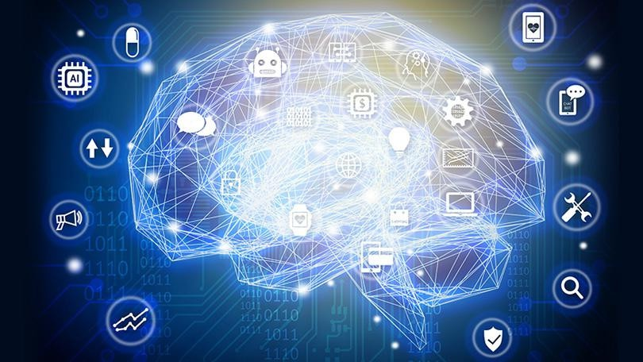
Steps for learn Machine Learning
Introduction to Machine Learning:
Foundational Knowledge:
Understanding Data:
Introduction to Algorithms:
Community Involvement:
Continuous Learning:

Slide 10
Modules for machine learning
In previous days, the users used to perform tasks of machine learning by manually coding all the algorithms using mathematical and statistical formulas.
But in today's world, users can use the Python language, which is the most popular and pro learning.
NumPy
TensorFlow
Pandas
Matplotlib

Slide 11

NumPy Library
NumPy is the most popular library in Python.
This library is used for processing large multi-dimensional array and matrix formation by using a large collection of high-level mathematical functions and formulas.
It is widely used for linear Search , transformation, and random number capabilities.

Slide 12

Pandas Library
Pandas is a Python library used for working with data sets.
Pandas allows us to analyze big data and make conclusions based on statistical theories.
The developers have to prepare the dataset before using it for training the machine learning.
It has a wide variety of tools for analysing data in detail, providing high-level data structures.

Slide 13




Thank You

